Slide 1
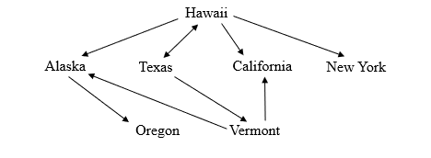
CMSC204
Kartchner
V(StateGraph) = {Oregon, Alaska, Texas, Hawaii, Vermont, NewYork, California}
E(StateGraph) = {(Alaska, Oregon), (Hawaii, Alaska), (Hawaii, Texas), (Texas, Hawaii), (Hawaii, California), (Hawaii, New York), (Texas, Vermont), (Vermont, California), (Vermont, Alaska)}
1. Draw the StateGraph

Slide 2
a. Show the adjacency matrix that would describe the edges in the graph. Store the vertices in alphabetical order
States
Alaska
0 0 0 0 1 0 0
California
0 0 0 0 0 0 0
Hawaii
1 1 0 1 0 1 0
New York
0 0 0 0 0 0 0
Oregon
0 0 0 0 0 0 0
Texas
0 0 1 0 0 0 1
Vermont
1 1 0 0 0 0 0
3. b. Show the adjacency lists
that would describe the edges in the graph
Alaska
Oregon
California
Hawaii
Alaska
California
Alaska
NY
New York
Oregon
Texas
Vermont
Hawaii
Vermont
Alaska
California

Slide 3
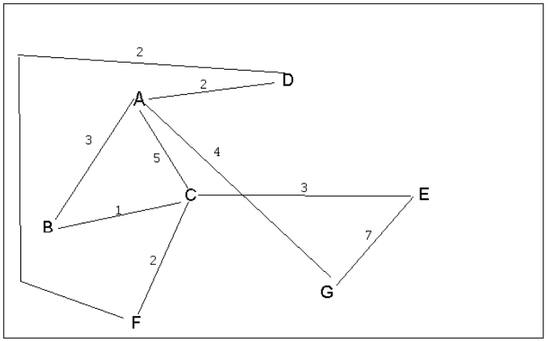
4 a. Which of the following lists the graph nodes in depth first order beginning with E?
A) E, G, F, C, D, B, A
B) G, A, E, C, B, F, D
C) E, G, A, D, F, C, B
D) E, C, F, B, A, D, G
4 b. Which of the following lists the graph nodes in breadth first order beginning at F?
A) F, C, D, A, B, E, G
B) F, D, C, A, B, C, G
C) F, C, D, B, G, A, E
D) a, b, and c are all breadth first traversals

Slide 4
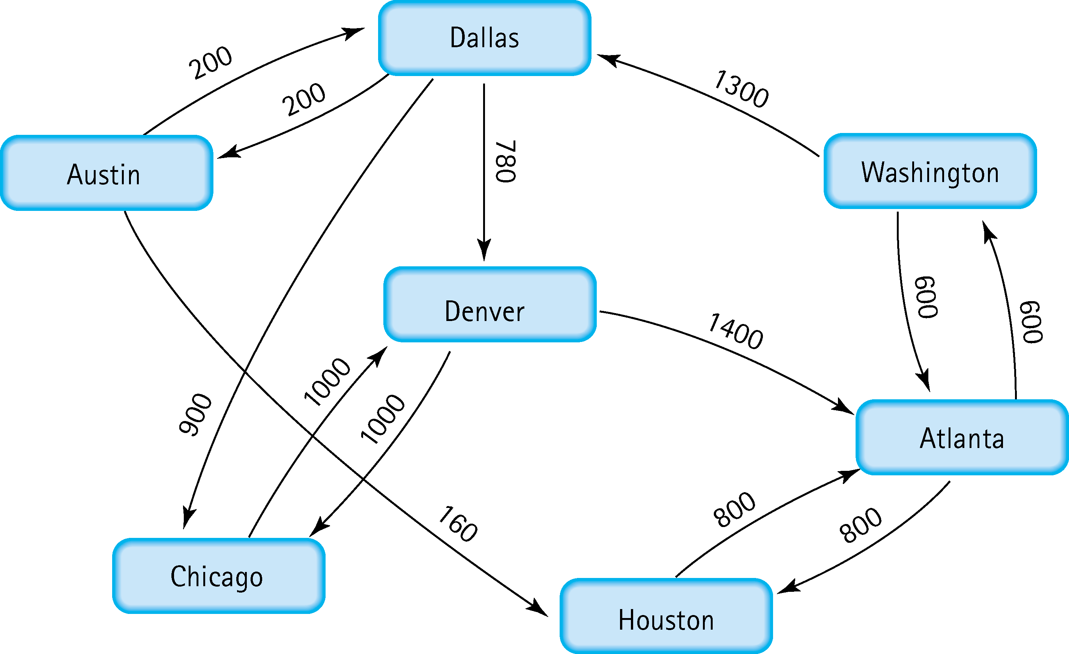
5. Find the shortest distance from Atlanta to every other city Atlanta – Austin 600 + 1300 + 200 = 2100
Atlanta – Chicago 600 + 1300 + 900 = 2800
Atlanta – Dallas 600 + 1300 = 1900
Atlanta – Denver 600 + 1300 + 780 = 2680
Atlanta – Houston 800
Atlanta – Washington 600

Slide 5
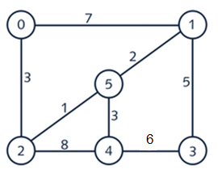
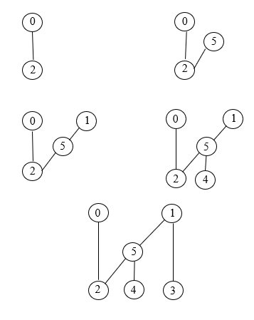
6. Find the minimal spanning tree using Prim’s algorithm. Use
0 as the source vertex . Show the steps.

Slide 6
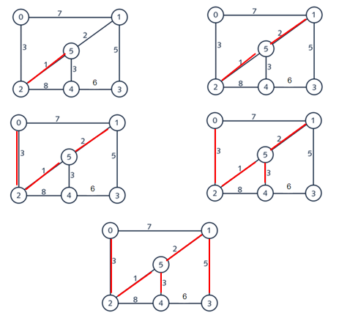
7. Find the minimal spanning tree using Kruskal’s algorithm.
Show the weights in order and the steps.
2 – 5 : 1
1 – 5 : 2
0 – 2 : 3
4 – 5 : 3
1 – 3 : 5

Slide 7
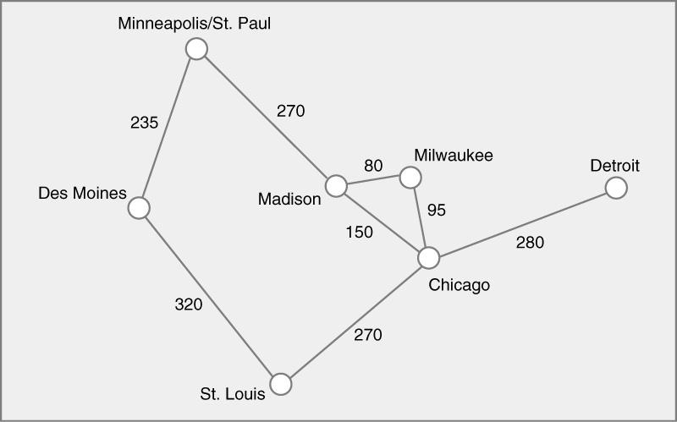
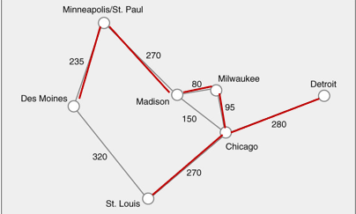
8. Find the minimal spanning tree using the algorithm you prefer. Use
Minneapolis/St. Paul as the source vertex
Using Kruskal’s:
Mad-Mil: 80
Mil-Chi: 95
Mad-Chi: 150
Min-Des: 235
Min-Mad: 270
Chi-StL: 270
Chi-Det: 280
Des-StL: 320

Slide 8
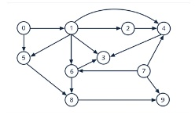
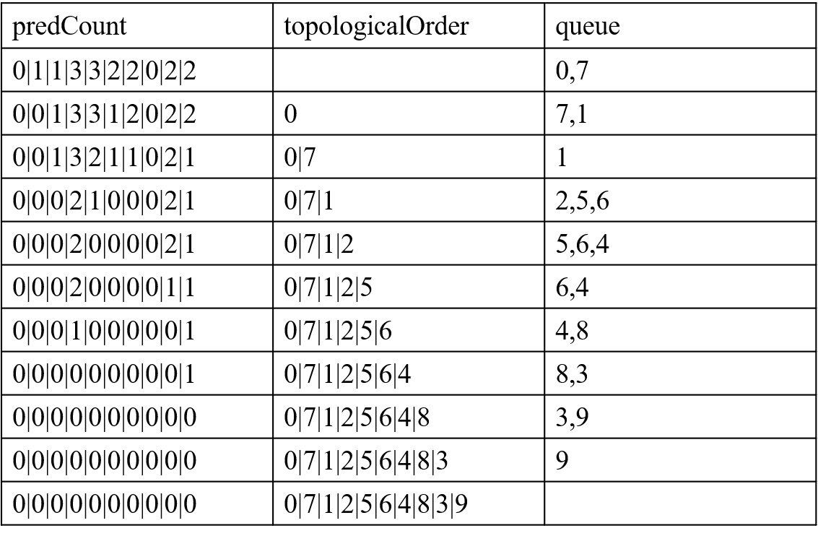
9. List the nodes of the graph in a breadth first topological ordering. Show the
steps using arrays predCount, topologicalOrder and a queue

Slide 9
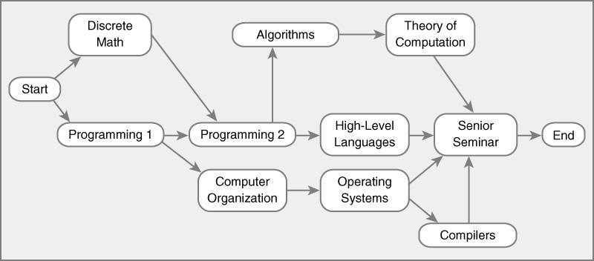
10. List the nodes of the graph in a breadth first topological ordering.
Start
Discrete Math
Programming 1
Programing 2
Computer Organization
Algorithms
High-Level Languages
Operating Systems
Theory of Computation
Compilers
Senior Seminar
End

